Slide 1
Super Eastgate
Jonathan Caron
Ryan Fleming
Antonio Guarino
Mike LoVerme

Slide 2
Overview
Super EastGate is a basic 2D side scroller game that runs on Microsoft Windows.
Customizable graphics, sounds, levels, and controls.
Future game pack downloads for extended play!

Slide 3
Story
Jason EastGate is an incoming freshman to Merrimack College. He really loves his hair more than anyone could ever think possible. When he came to Merrimack there were many people who thought he would much better with shorter hair and no beard. Jason did not appreciate this.

Slide 4
Story Continued
When Jason started to attend classes, he found various people trying to chase after him with scissors and offering razors to shave his beard. He found that jumping on top of peoples heads would make the scissors disappear. This made Jason very happy. He also found that rejecting the razors gave him more self confidence and grew his ability to withstand pain.

Slide 5
What you need to do!
You get to control Jason on his endeavor to get to class.
You must avoid scissors and collect “no razor” symbols to become more powerful.
Get to the flag before time runs out and Jason is late to class!

Slide 6
More to the story
People soon realized that Merrimack College has many gaps in the ground. In an attempt to still get Jason, people with scissors learned about these gaps and could start to avoid them.

Slide 7
Organization
Used Google Code to organize and share the project files with all of the developers.
Can be found at:
http://code.google.com/p/merrimack-college-csc4910-sp2010/

Slide 8
Documentation
Proposal
Requirements Analysis Document
System Design Document
Object Design Document
Implementation and Testing Document
Weekly Status Reports
Meeting Minutes

Slide 9
Win32 API
Message pump
  Key handler
  Window resize
  Window creation
Ticks

Slide 10
OpenGL
Cross platform graphics library that allows you to create objects and display them in a window.
Drawing objects
Square based
Transparency
Turning 3D into 2D

Slide 11
OpenAL
Audio library built by Creative Labs in order to make putting audio into programs easier.
Uses a buffer system
Enables 3D audio
Allows for looping files
Multiple sounds at once

Slide 12
Making things work together
Level loader
Movement
Gravity
AI
Collision detection

Slide 13
Level Loader
Each level is created as it is needed.
  Also known as delayed loading.
Pulls the level from .ini file
Consists of World objects and level objects

Slide 14
Character Movement
The onscreen character appears to move left and right, but the world itself is moving.
The character can jump.
Gravity is constantly acting on the onscreen objects, both the character and the AI

Slide 15
Artificial Intelligence
(or lack thereof)
Two types of AI
  “Dumb” AI
    Only moves to the right and falls off of cliffs
  “Not so Dumb” AI
    Moves in either direction and will not fall off of cliffs

Slide 16
Collision Detection
When two objects meet …
List of objects on screen
GameDude status set to falling
Compared to each object on screen
AI to screen
GameDude to AI

Slide 17
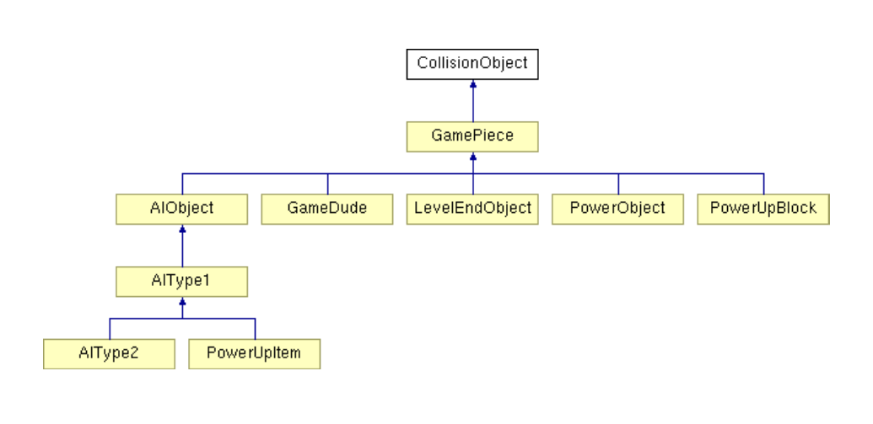
Class Structure

Slide 18
Making the World Come Alive
Level Design
Graphics Creation
Audio Creation

Slide 19
Crafting the World
Uses .ini files to outline where blocks are in the world, in addition to power ups and enemies.

Slide 20
Designing the Graphics
Made using Adobe Photoshop
All graphics based off of 100 x 100 pixel squares
  Blocks
  End of level flag
Graphics were .TGA files
Alpha channel for transparency
Vibrant pink background layer

Slide 21
Audio
Used FL Studios and Audacity to create a custom soundtrack
Tried to base sounds off similar audio tracks from games of same genre.
Used .wav files

Slide 22
Future Goals
Level Editor
Save Progress
Animation
Bosses!
Performance Tweaks

Slide 23
Questions?
  Comments?
    Concerns?

Slide 24
The End?
Or is it?!
The events of this game are entirely fictitious, any likeness to a real person is entirely coincidental.

Slide 25
Demo Time
Who wants to play?

